Slide 1
Introduction to Databases
Introduction to databases
As you begin to build applications, it will become increasingly apparent that you’ll need to store data in some sort of persistent storage mechanism. And, ultimately, you'll want to allow access to that data via your application.
Whether you are building a small application with access limited to employees or a feature-rich Internet web store that millions will visit, you will need some system for storing all of that information.
Like a filing cabinet that stores files and, subsequently, data within those files, you will need some mechanism of storing all your data for easy access and quick retrieval. That mechanism is the database.

Slide 2
Introduction to Databases
Introduction to databases
In the next couple of lectures we’ll attempt to demystify databases by providing a short, yet simple to understand introduction to databases.
We’ll cover basic database concepts such as tables, columns, and rows, as well as advanced concepts such as views and queries, relationships, and keys.
We’ll discuss various database options that are available to you. Some are free, others are open source, and yet others are costly, large, and can require teams and resources to maintain.
We’ll also look at the Database Management System (DBMS) which allows you to visually connect to and manage a database easily.

Slide 3
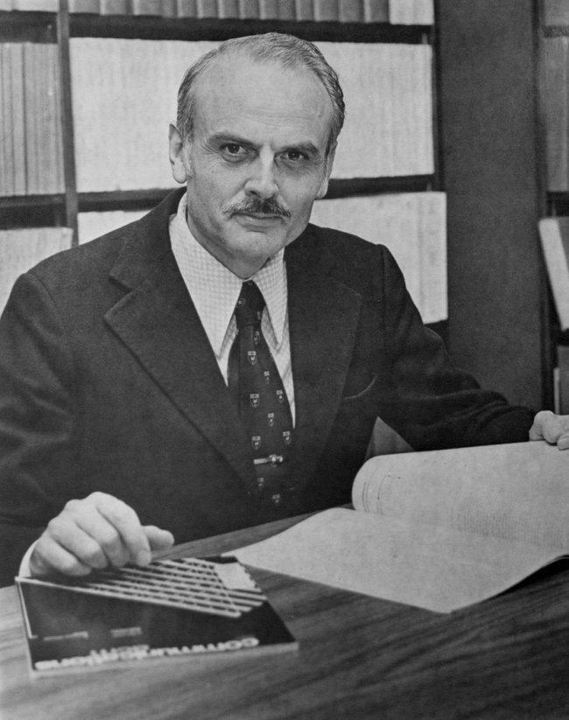
Introduction to Databases
Introduction to databases
In 1970, E. F. Codd, an IBM employee, proposed his idea for what would become the first relational database design model.
His idea of “relational” stemmed from the fact that data and the relationships between them were organized in “relations,” or what we know today as tables.
Even though Codd’s terminology of what we refer to as tables, columns, and rows was different, the premise behind the relational model has remained consistent.
Although the model has undergone revisions and changes since he presented it almost 50 years ago, the idea of storing and retrieving information in large applications has not changed, solidifying the need for the relational database model.

Slide 4

Introduction to Databases
Anatomy of a database
The best way to think of a database is in terms of a filing cabinet. Why? Because filing cabinets are what we used before databases and the concepts that surround databases mirror that of a filing cabinet.
The filing cabinet contains drawers, the drawers contain folders, and the folders contain documents that have information on them.
A database is similar in concept.
A database (the filing cabinet) contains drawers, otherwise known as tables; those tables contain folders, or columns, which in turn contain rows of information pertaining to the particular column that they’re in.

Slide 5
Introduction to Databases
Anatomy of a database
Consider building a help desk application for an organization. You would definitely want to use a database here in order to maintain a historical record of all employee/customer communication. If we were to build this application we might consider following types of information:
Employees - We need some way of keeping track of all employees who work for the organization that have access to this application. These employees will have access to the application and will respond to customer’s support needs.
Customers – Your organization could potentially have hundreds of customers. Those customers might need technical support at some point. When they do, the help desk application will be there for them to submit a customer support request.
Tickets – Once a customer submits a support request, an employee will need to respond to that customer’s need. We would need some way of storing and keeping track of all of these requests.

Slide 6
Introduction to Databases
Anatomy of a database
In the "old days", an employee might be assigned to a group of last names. Sally Employee assigned to last names beginning with A-B, Mark Employee assigned to last names beginning with C-D, etc.
Whenever a customer calls, a paper record is made for that customer that tracks communication, interactions, support, etc. through the pipeline.
At the end of the day, that record is filed away in a massive filing cabinet so that it may be retrieved at a later date.
In more modern times, we could also take these elements and create a spreadsheet.
We could then physically write in these documents whenever a customer calls the help desk.
Then, we take these documents and store them in folders alphabetically and even store all the folders within one central metal filing cabinet.
These are classic examples of how (an inefficient) business can work!

Slide 7
Introduction to Databases
Anatomy of a database
The processes mentioned in the previous slide closely resembles how the modern database operates in relation: The filing cabinet (the database), the drawers (tables), folders (columns and rows), and even the documents within them (data) - all represent the basic components of a modern database structure:
The Database
Tables
Columns
Rows
Data

